Slide 1
Lesson 25 – Continuous Integration & Continuous Delivery

Slide 2
Lesson Goals
Continuous Integration
Continuous Delivery
Spring Boot Useful Features
Monitoring

Slide 3
Software build process
Building software is hard and require big amount of time!
Software build process:
Develop
Test
Assemble
Deploy
Integrate
Repeat
Again and again and again… 🤪

Slide 4
What is CI/CD

Slide 5
Continuous Integration Process
Detects errors as quickly as possible: fix problems while fresh in developers mind
Reduces integration problems: smaller problems are easier to fix
Avoid compounding problems: allows teams to develop faster, with more confidence

Slide 6
Continuous Delivery Process
Ensures every change is releasable: test everything, including deployment, before calling it done
Lowers risk of each release: makes releases “boring”
Delivers value more frequently: reliable deployments mean more releases
Tight customer feedback loops: fast and frequent customer feedback on changes

Slide 7
How it works

Slide 8
Basic CI/CD flow

Slide 9
Detail CI/CD flow

Slide 10
CI/CD provider for projects

Slide 11
GitLab pipeline glossary
Commit: A code change.
Job: Instructions that a runner has to execute.
Pipeline: A collection of jobs split into different stages.
Runner: An agent or server that executes each job individually that can spin up or down as needed.
Stages: A keyword that defines certain stages of a job, such as build and deploy. Jobs of the same stage are executed in parallel.

Slide 12
GitLab CI/CD flow example
Pipelines are configured using a version-controlled YAML file, .gitlab-ci.yml, within the root of a project.

Slide 13
.gitlab-ci.yml example
image: adoptopenjdk/openjdk11:latest stages: - build - deploy before_script: - chmod +x gradlew build: stage: build script: ./gradlew build artifacts: paths: - target/demo-0.0.1-SNAPSHOT.jar production: stage: deploy
image: ruby:latest script: - …
only: - master

Slide 14
So CI is done, but what about CD
Heroku as a prod server/hosting provider
Postgre DB with 10000 rows limit
Getting started with Gradle on Heroku

Slide 15
Spring Boot Useful Features

Slide 16
Spring Boot Profiles

Slide 17
Profiles code usage
public interface DatasourceConfig { void setup(); }
@Component @Profile("dev") public class DevDatasourceConfig implements DatasourceConfig { @Override public void setup() { System.out.println("Setting up datasource for DEV environment. "); } } @Component @Profile("production") public class ProductionDatasourceConfig implements DatasourceConfig { @Override public void setup() { System.out.println("Setting up datasource for PRODUCTION environment. "); } }

Slide 18
Profiles code usage
public interface DatasourceConfig { void setup(); }
@Component @Profile("dev") public class DevDatasourceConfig implements DatasourceConfig { @Override public void setup() { System.out.println("Setting up datasource for DEV environment. "); } } @Component @Profile("production") public class ProductionDatasourceConfig implements DatasourceConfig { @Override public void setup() { System.out.println("Setting up datasource for PRODUCTION environment. "); } }

Slide 19
Profiles Example in IDE
Profile configuration
Missing prod bean in dev config
Set profile from IDE, command line arg (-Dspring.profiles.active=profile)
Profiles config via *-profile.properties

Slide 20
Spring Boot Actuator 2.X
Actuator brings production-ready features to our application:
Monitoring our app
Gathering metrics
Understanding traffic
And many more…

Slide 21
Some of predefined endpoints
/beans – returns all available beans in our BeanFactory. Unlike /auditevents, it doesn't support filtering
/configprops – allows us to fetch all @ConfigurationProperties beans
/env – returns the current environment properties. Additionally, we can retrieve single properties
/flyway – provides details about our Flyway database migrations
/health – summarises the health status of our application
/info – returns general information. It might be custom data, build information or details about the latest commit
/logfile – returns ordinary application logs

Slide 22
Some of predefined endpoints
/metrics – details metrics of our application. This might include generic metrics as well as custom ones
/scheduledtasks – provides details about every scheduled task within our application
/shutdown – performs a graceful shutdown of the application
/threaddump – dumps the thread information of the underlying JVM
/heapdump – builds and returns a heap dump from the JVM used by our application

Slide 23
Additional tools

Slide 24
Code Quality

Slide 25
Error Tracking (Sentry.io)

Slide 26
App monitoring (Prometheus and Grafana)

Slide 27
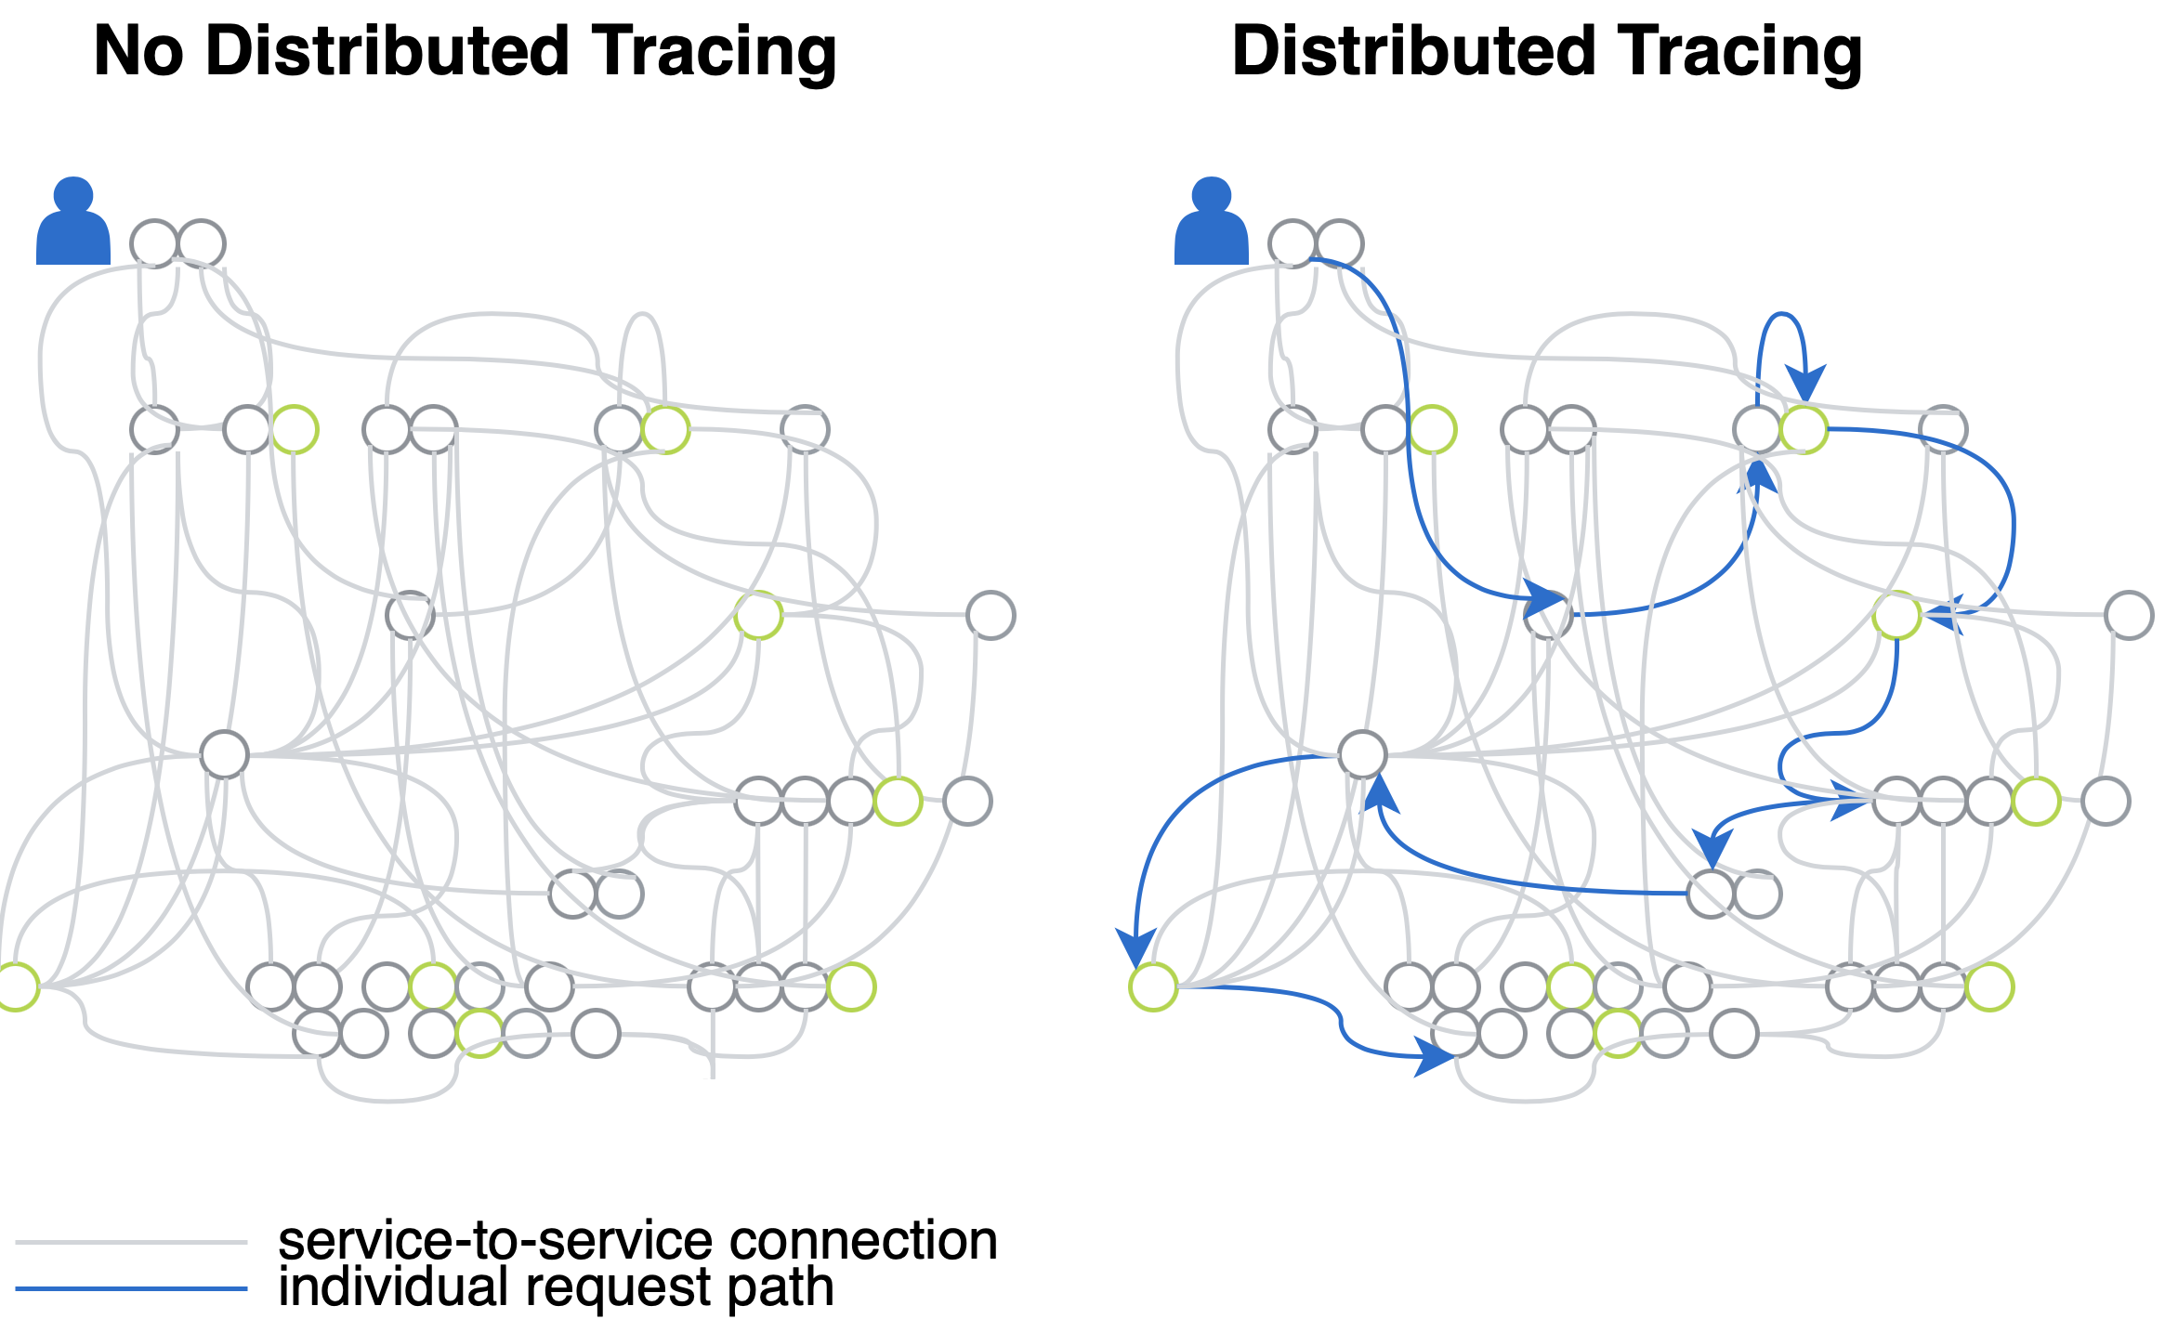
Distributed Tracing

Slide 28
Distributed Tracing (Zipkin)

Slide 29
Distributed Tracing (Zipkin)

Slide 30
Summary: All of that is DevOps

Slide 31
Course Work Task 1 (CI)
Add support of CI/CD by using Gitlab CI
Create and configure 3 stages:
build – used for building our application
test – used for running tests
deploy – used for delivering our application to prod on Heroku (required custom variable HEROKU_API_KEY setup on GitLab CI/CD settings )

Slide 32
Course Work Task 2 (CD)
Setup Course work application on Heroku
Use https://github.com/heroku/gradle-getting-started and https://devcenter.heroku.com/articles/git#for-an-existing-heroku-app for additional info during setup
Add support of Postgre DB as a production DB
Create “prod” profile that will contains config to Heroku DB
Use “prod” profile on Heroku
Local application should work with “H2” embedded DB by default

Slide 33
Course Work Task 3 (DevOps)
Add Spring Boot Actuator dependency
Allow access to actuator endpoints only for SUPER_ADMIN
Enable /shutdown endpoint
Enable other endpoints on your taste)
*Configure actuator on a separate port

Slide 34
Course Work Task 4 (DevOps)
https://sentry.io
https://sentry.io/for/spring/
https://github.com/getsentry/sentry-java/tree/master/sentry-spring-boot-starter

Slide 35
Literature
Building Spring Boot 2 Projects With Gradle
Continuous Integration
GitLab Deploy Spring Boot Example
Deploying Spring Boot Apps to Heroku
Getting started with Gradle on Heroku
Spring Boot Actuator
Spring Profiles

Slide 36
Thanks!
Any Questions?
Or find us in Slack:
@Yaroslav Brahinets
@Vasya Rudas

